Slide 2
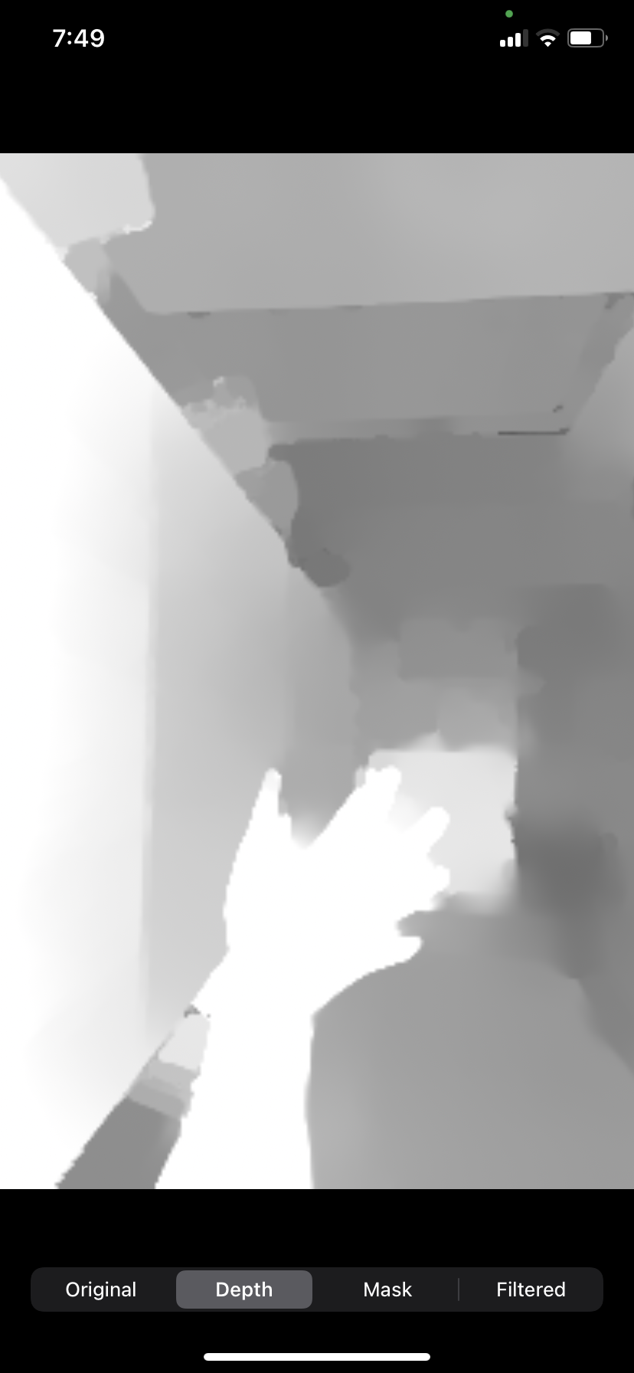
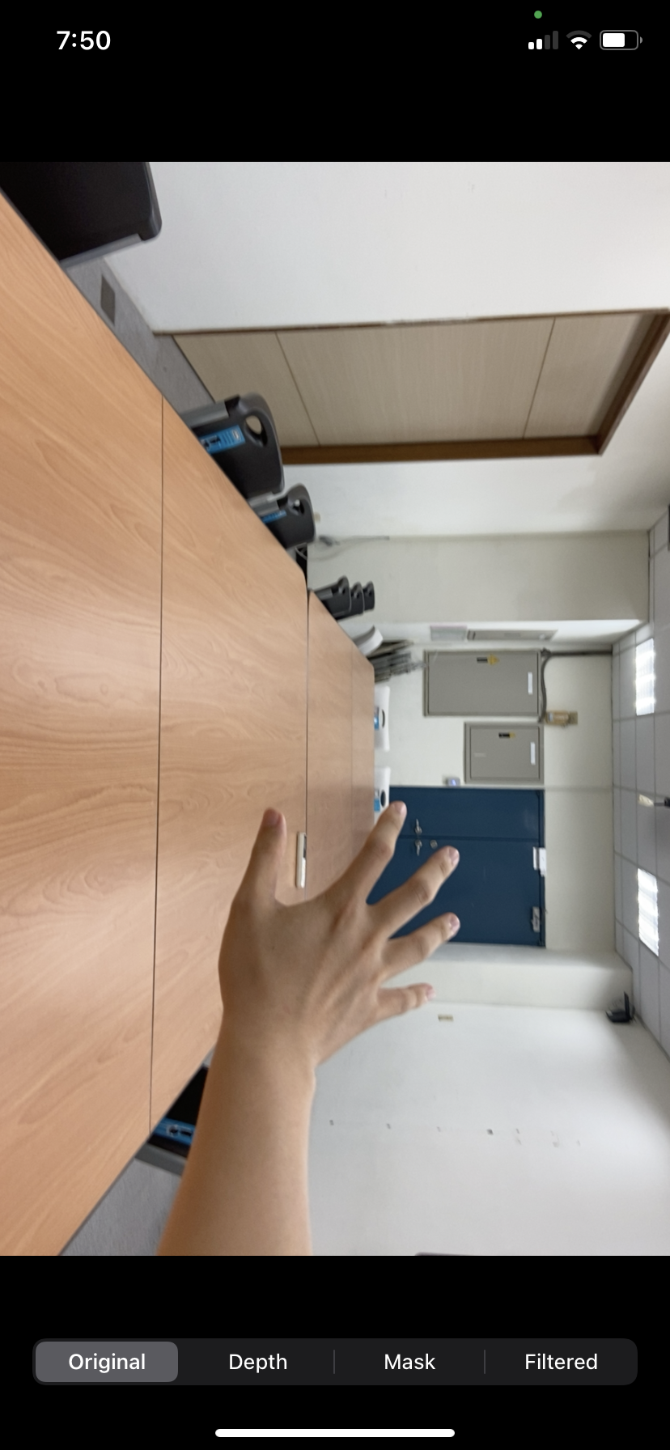
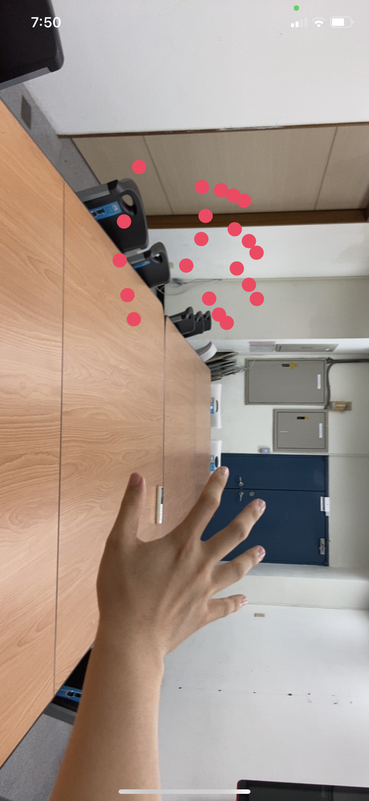
Software Ver 1: Reconstruct 3D
Dual Camera
Vision Library
AVCapturePhotoOutput
ML hand joints detector
Wide-angle image
(secondary camera)
Telephoto image
(main camera)
Disparity
2D
Hand joints result
Depth Map
AVCaptureSession
Main Tread
3D
Hand joints result
Renderer
Mirroring
Preview
Asyn Tread
UIViewController

Slide 3
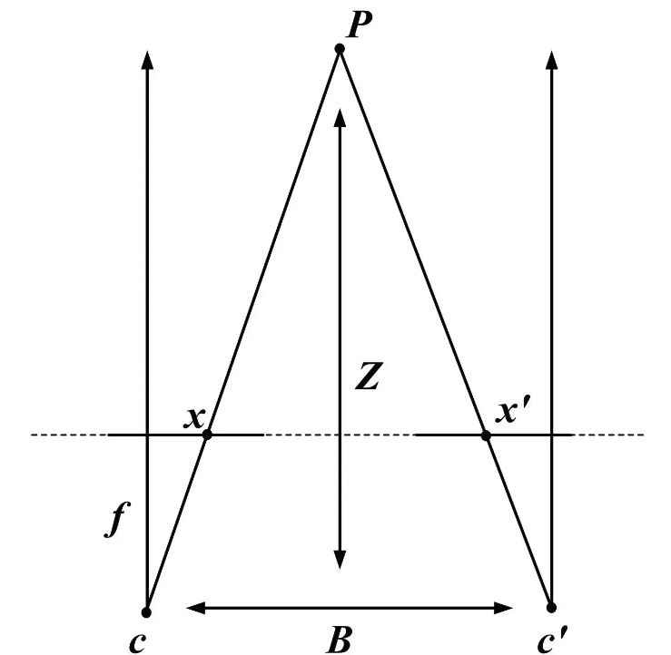
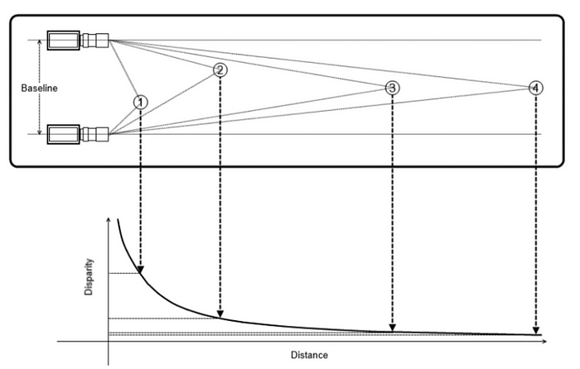
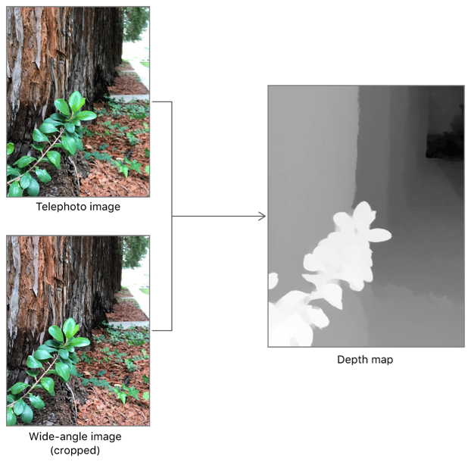
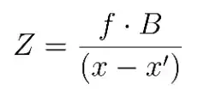
Dual camera estimate depth
EXP on iPhone 11
Output Value
9999.9f
0.2f
0.8f
“This level of accuracy indicates that values within a depth map are usable relative to one another (that is, a depth value of 2 is twice as far as a depth value of 1), but do not accurately convey real-world distance.”
Dramatically increase
Unstable increase
Linear decrees
Real Depth
0 cm
10 cm
20 cm
80 cm
Notes:
Ref:
https://www.digitalnuage.com/disparity-and-depth-estimation-from-stereo-camera
https://www.oreilly.com/library/view/learning-opencv-3/9781491937983/
https://developer.apple.com/documentation/avfoundation/avdepthdata/accuracy/relative
https://developer.apple.com/documentation/avfoundation/additional_data_capture/capturing_photos_with_depth

Slide 4
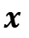


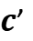
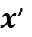
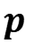
Dual camera estimate depth
$$p$$
$$z$$
$$p4$$
$p$1
Baseline
$$p2$$
$p$3
$$ƒ$$
$$c$$
$c$’
Disparity
$$x$$
$x$’
Depth

Slide 5

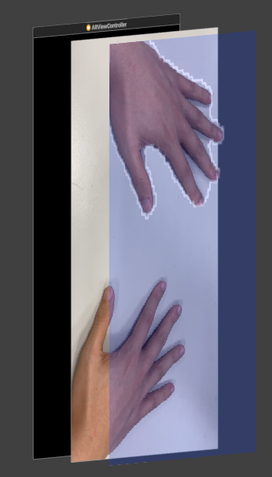
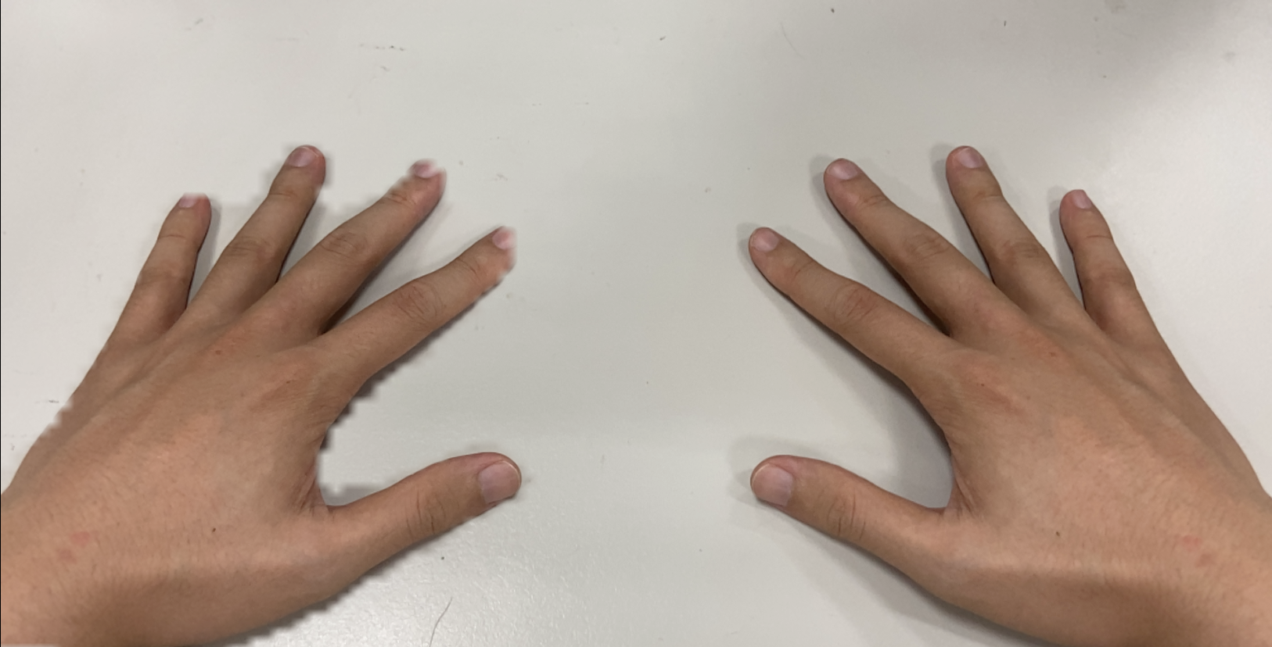
Software Ver 2: hand contour segmentation
Single Camera
CoreML Library
ARSession
ML hand contour detector
Current Frame
ARSession
Hand contour result
UIViewController
Sublayer
Main Tread
Transparency
Renderer
Rotate
(Mirroring)
Preview
Masking
Asyn Tread

Slide 6

VNHumanHandPoseObservation
thumb
indexFinger
middleFinger
thumb
indexFinger
middleFinger
thumbTIP
thumbIP
thumbMP
thumbCMC
indexTIP
indexDIP
indexPIP
indexMCP
middleTIP
middleDIP
middlePIP
middleMCP
thumbTIP
thumbIP
thumbMP
thumbCMC
indexTIP
indexDIP
indexPIP
indexMCP
middleTIP
middleDIP
middlePIP
middleMCP
ringFinger
littleFinger
wrist
ringFinger
littleFinger
wrist
ringTIP
ringDIP
ringPIP
ringMCP
littleTIP
littleDIP
littlePIP
littleMCP
ringTIP
ringDIP
ringPIP
ringMCP
littleTIP
littleDIP
littlePIP
littleMCP

Slide 7
Software Ver 3: cardboard support
Single Camera
ARConfiguration
ARSession
ML Person Segmentation
Current Frame
ARSession
Contour texture result
AppCoordinator
Rotate
(Mirroring)
Renderer
Shader
Preview
Frame buffer
Camera preview
Cardboard preview
Metal
GPU acceleration
CPU Main Tread

Slide 8

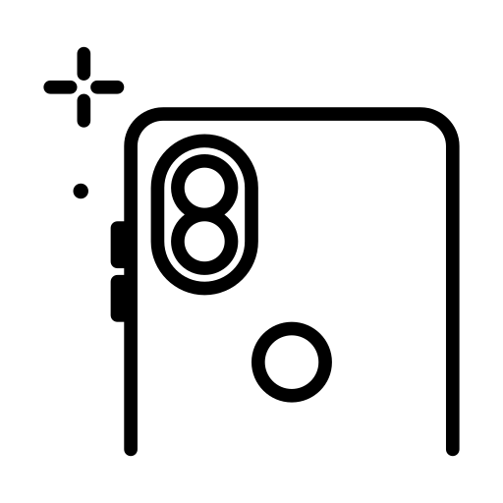


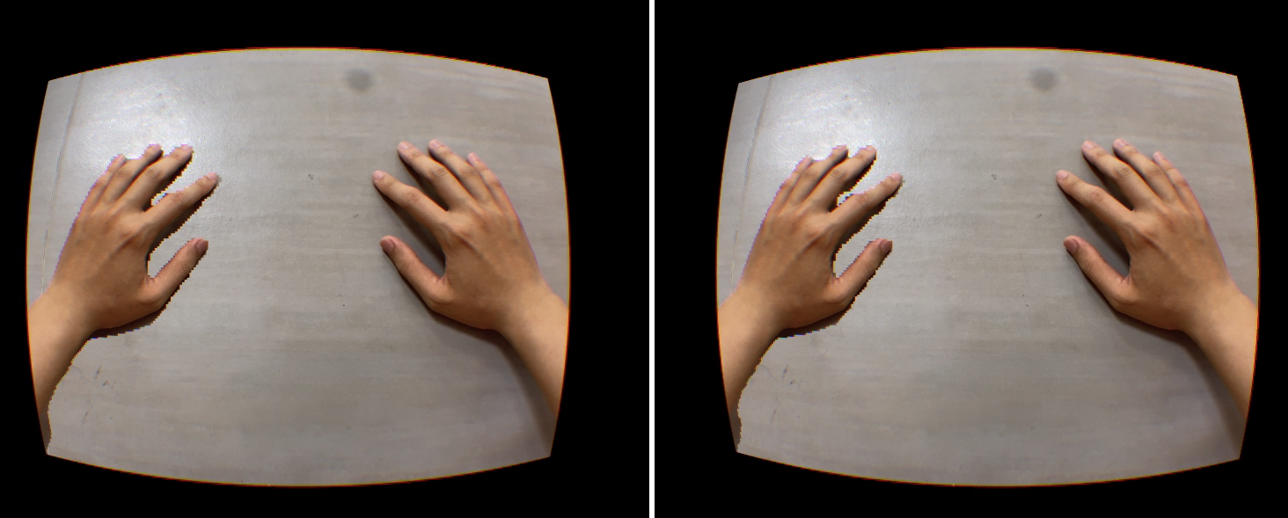
System Architecture
Subject with hemiplegia
Hardware and Accessories
ARMT system
AR tasks pipline
Frames with the human body
Human body segmentation
Performs excersice
Texture shader
iPhone iOS 15+
Frame buffer
GUI
Binocular rendering
Randerer
VR Cardboard
Real time Mirror Display

Slide 9
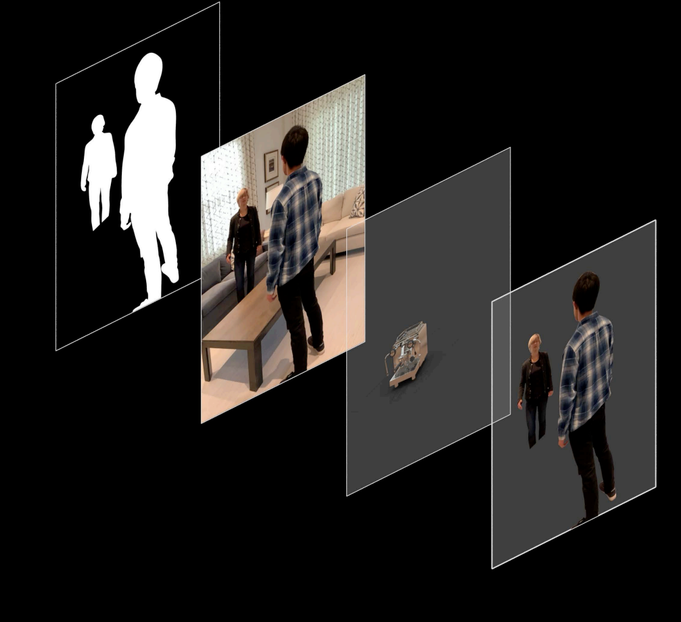
Segmentation
Camera
Rendering
People

Slide 10
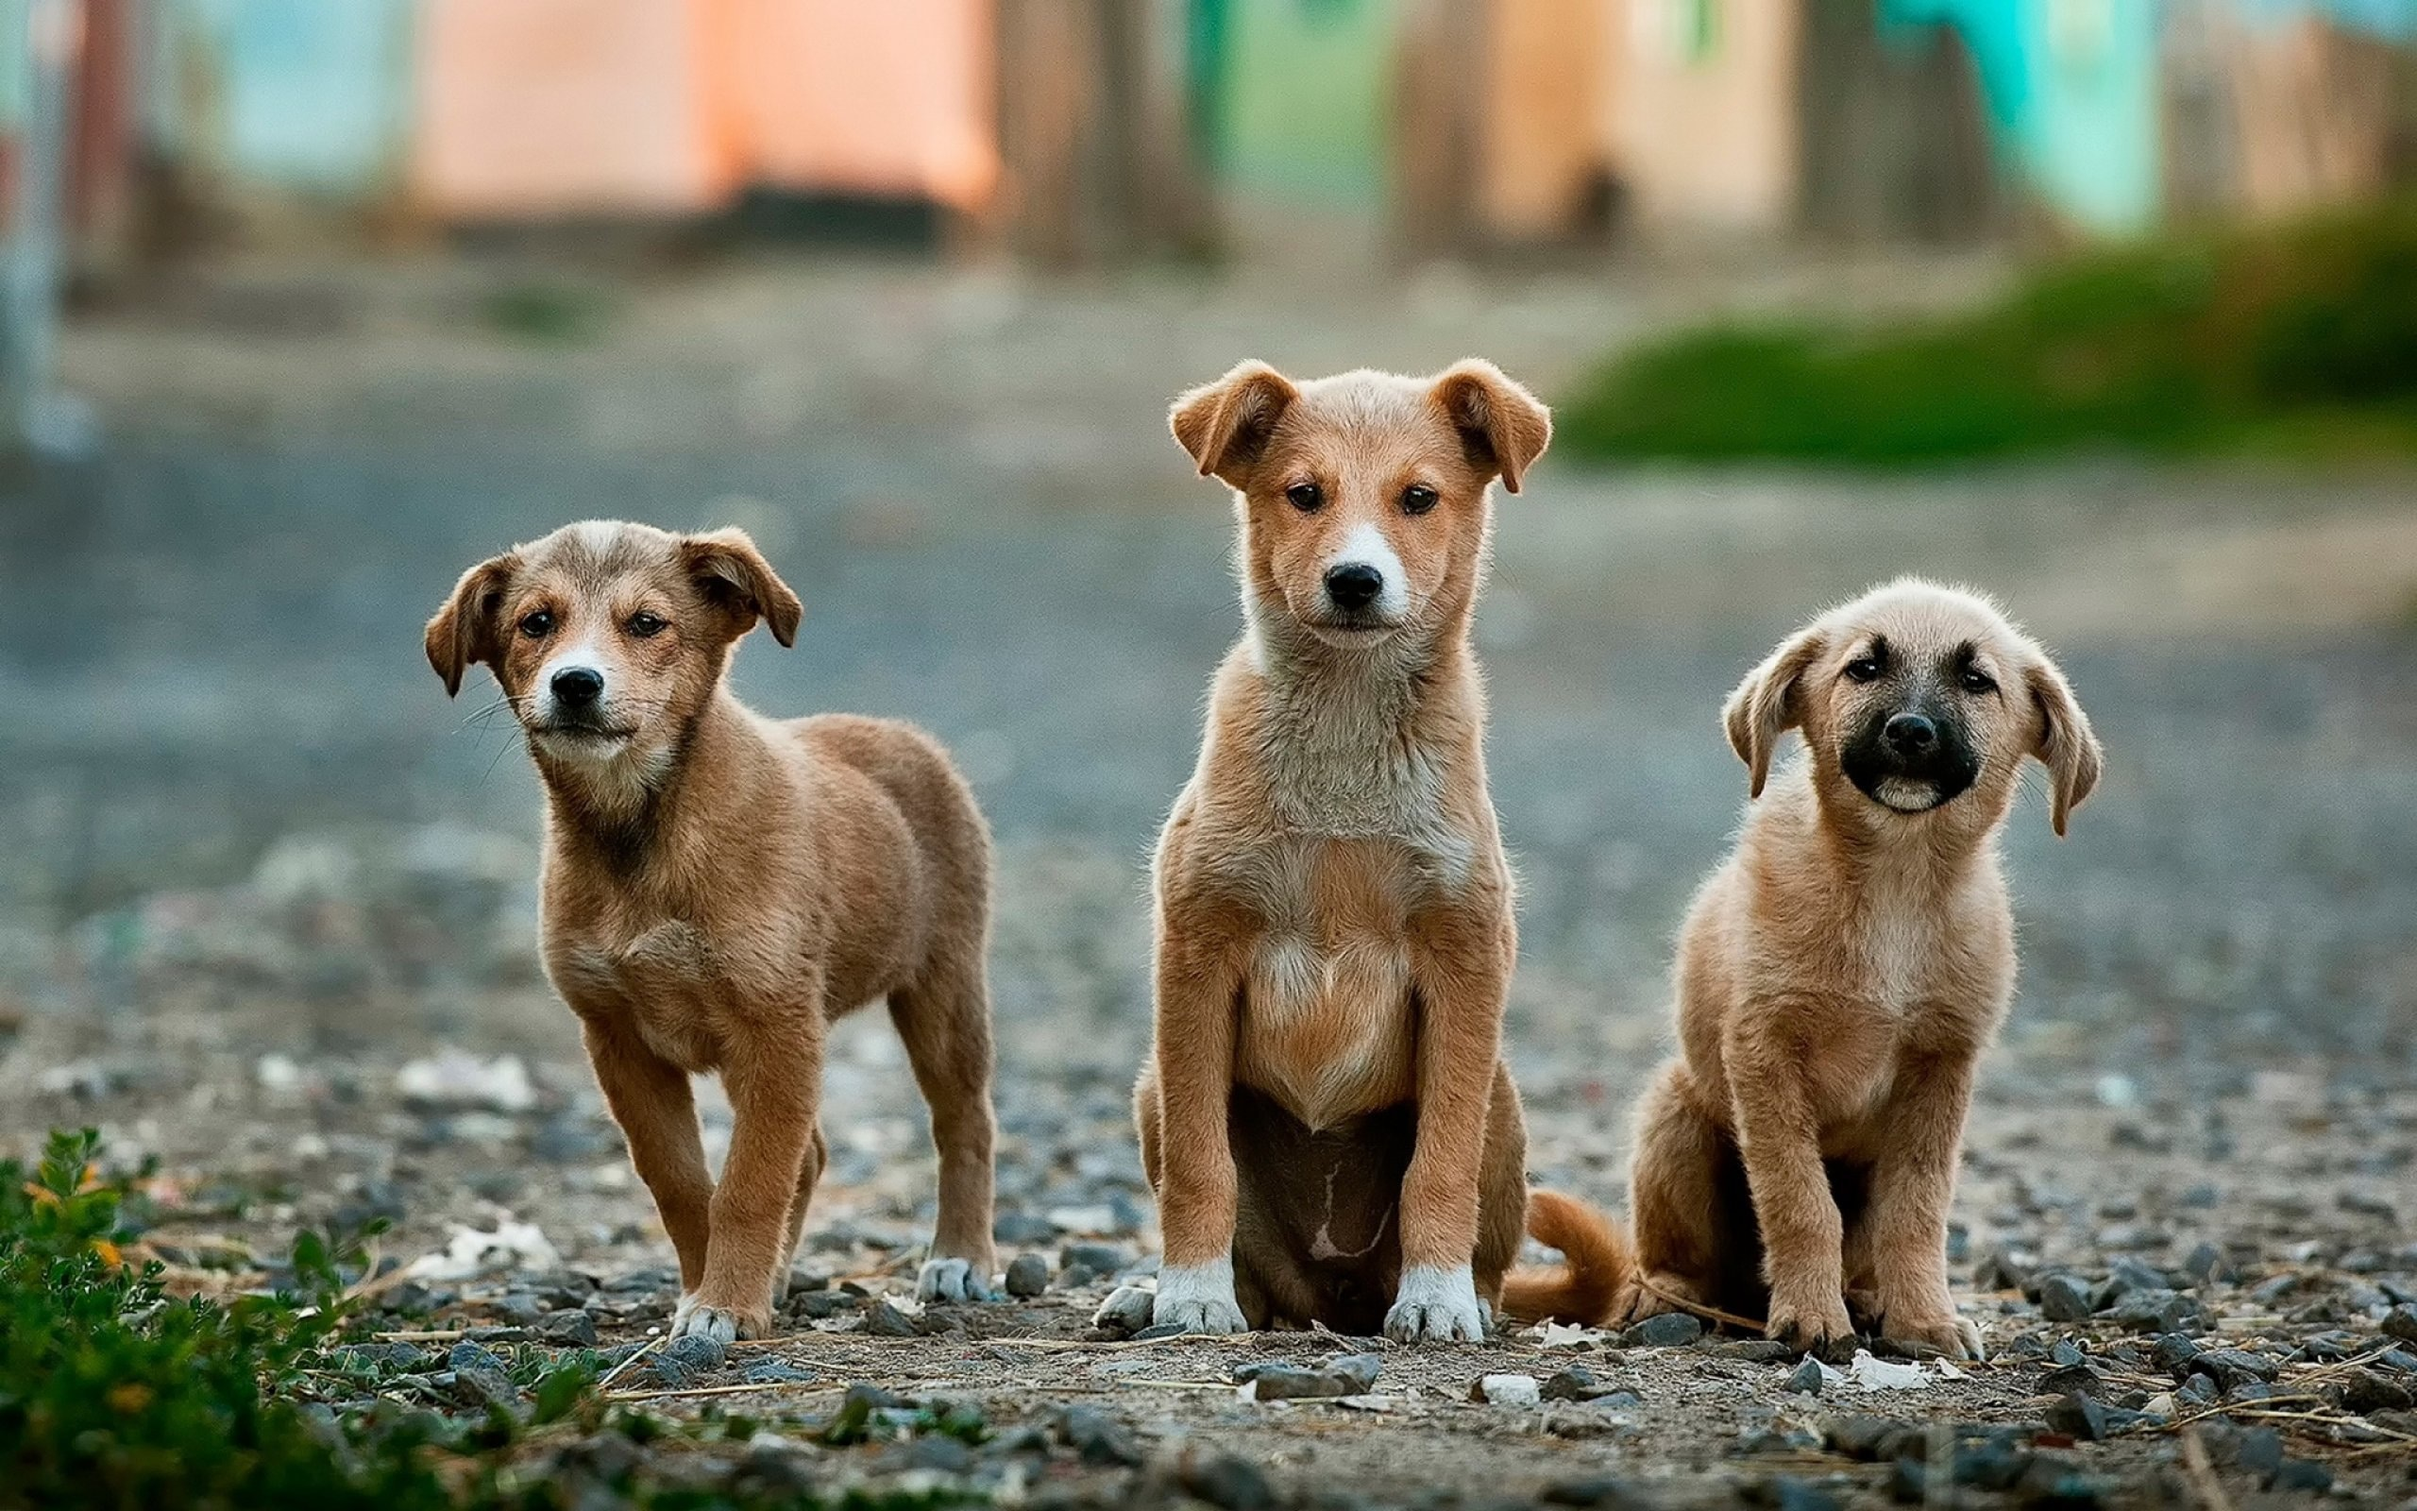
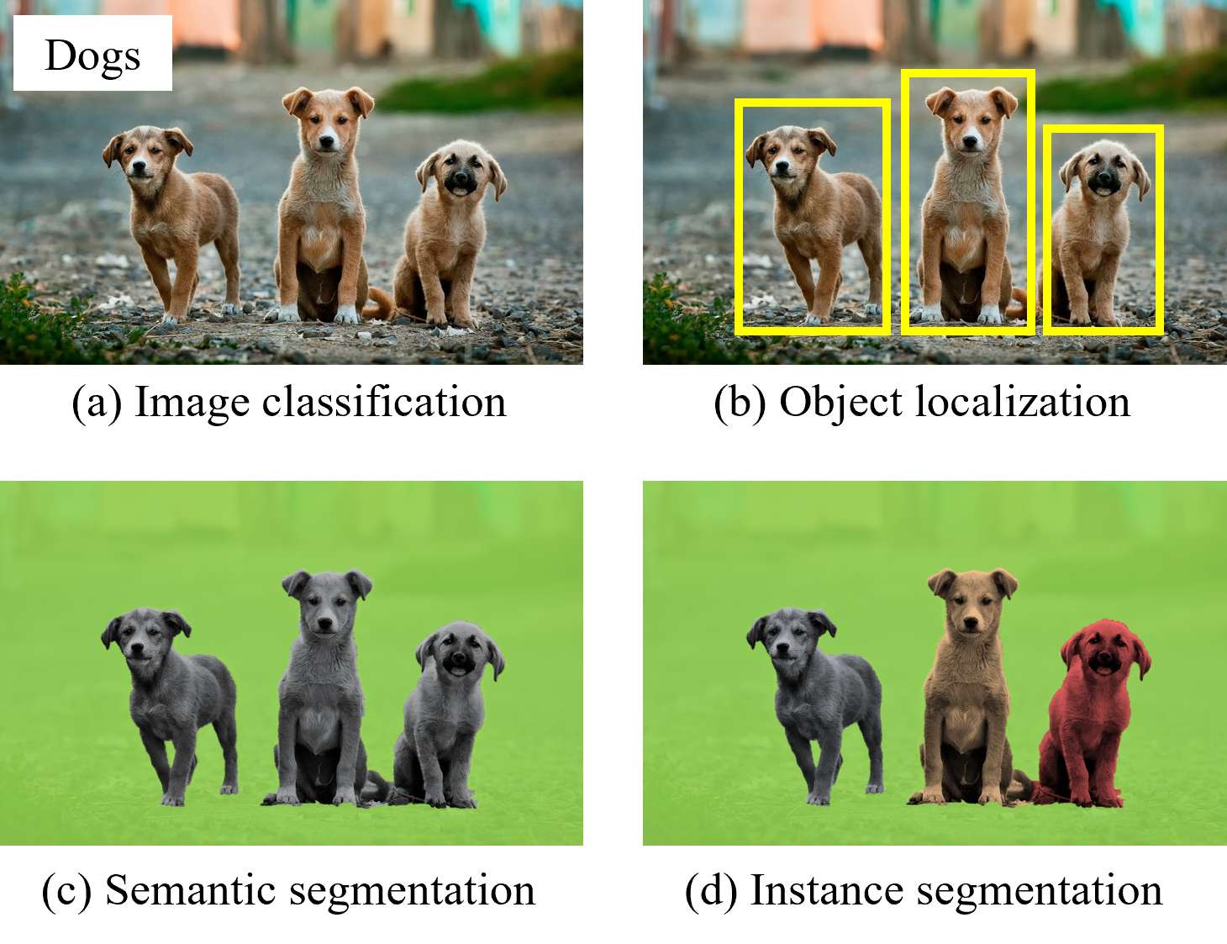
Dogs
(a) Image classification

Slide 11
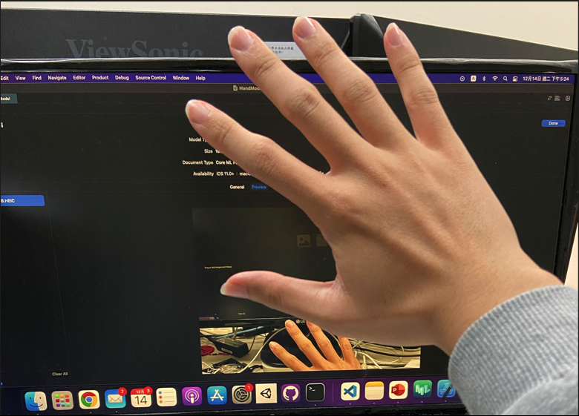
Input image 3x224x224
Output mask
3x112x112
32
16
32
16
16
112*112
112*112
24
24
48
24
56*56
56*56
x2
Stride = 1
32
32
64
32
28*28
28*28
Stride = 2
x3
x3
Conv 1x1
64
64
96
192
96
Conv 3x3
14*14
14*14
Deconv 4x4
160
160
x2
320
1280
Linear Bottleneck
7*7
Linear Bottleneck with residuals

Slide 12
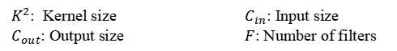
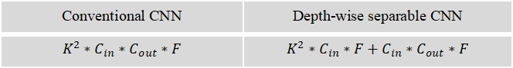
Linear Bottleneck
Stride = 1 block
Conv 3x3
Depth-wise Conv 3x3
Input
Input
Batchnorm
Batchnorm
Conv 1x1
Conv 1x1
Relu
Relu
Batchnorm + Relu6
Batchnorm + Relu6
Conv 1x1
Depth-wise Conv 3x3
Depth-wise Conv 3x3
residuals
Batchnorm
Batchnorm + Relu6
Batchnorm + Relu6
Relu
Conv 1x1, Linear
Conv 1x1, Linear
Conventional CNN | Depth-wise separable CNN
$$K^{2}∗C_{in}∗C_{out}∗F$$ | $$K^{2}∗C_{in}∗F+C_{in}∗C_{out}∗F$$
$K^{2}$: Kernel size $C_{in}$: Input size
$C_{out}$: Output size $F$: Number of filters
Output
Output
(a) Architecture and calculation comparison between traditional CNN and depth-wise separable CNN
(b) Architecture of linear bottleneck and residuals network (inverted residuals)

Slide 13
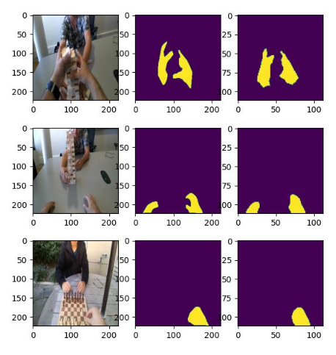
Validation Source
Ground
Truth
Output
Result

Slide 14


Training set
4000 sets of data
Epoch = 200
EgoHands dataset
Split 5:1
Random masking filter
Fit
Modified Unet
Batch size = 8
Rotation
Horizontal flip
Generate model
Brightness
Contrast
4800 sets of data
RGB shift
HSV shift
Evaluate the model
Gamma
Dropout
Loss function
800 sets of data
Min loss
Validation set
Predictive model

Slide 15


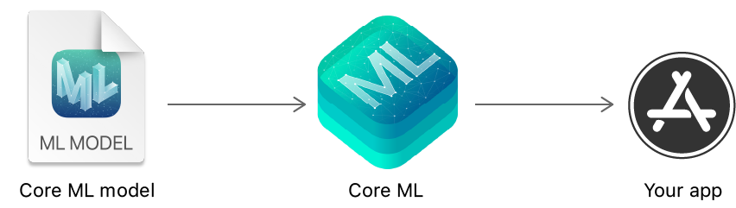
PyTorch model
Torch.jit.trace
TorchScript model
Coremltools.convert
+
VNCoreMLModel
ARMT APP
Core ML
Core ML model

Slide 16
Sub view layer
Main view layer
Background layer

Slide 17
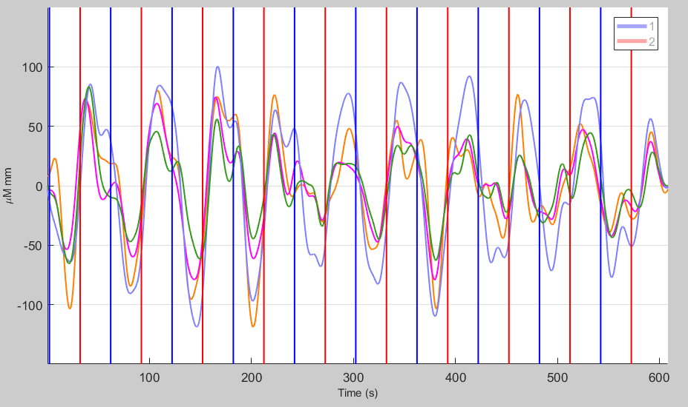
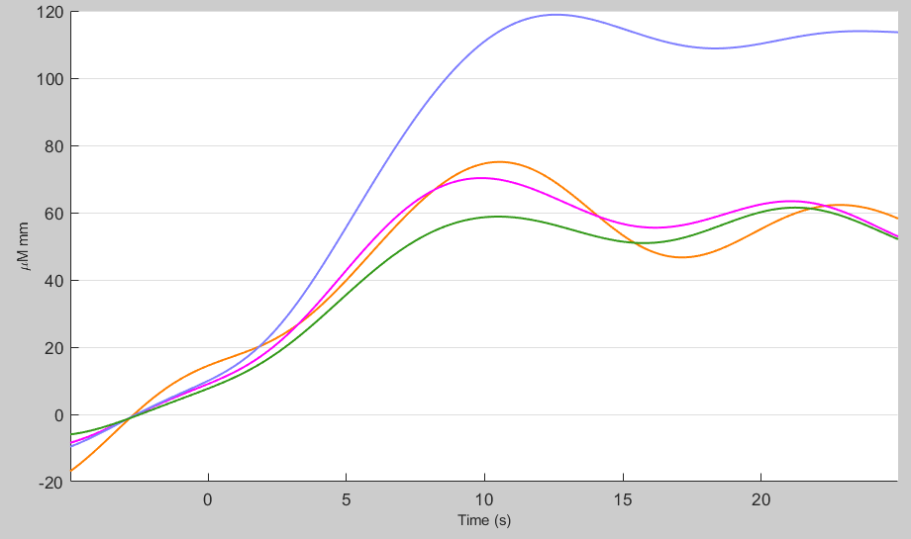
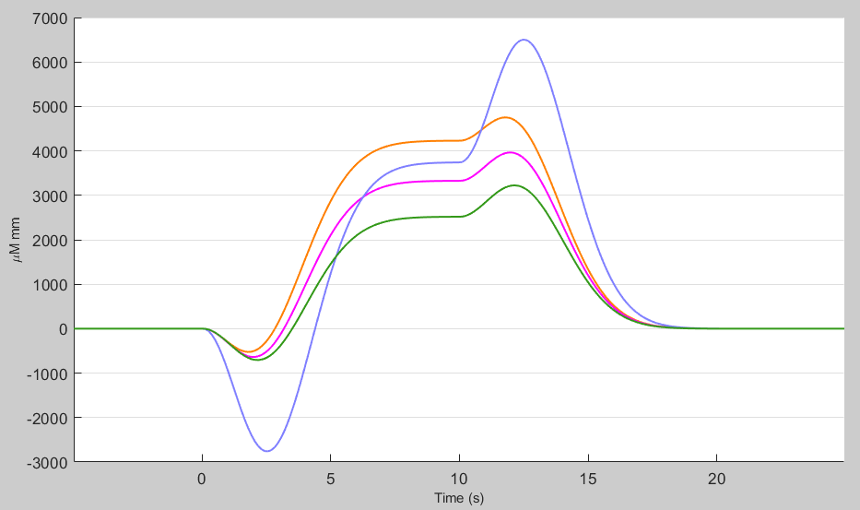
Resting stage
Pinching stage
(a)
(b)
(c)

Slide 18
Dominant Hand (DH)
Non Dominant Hand (Non-DH)
Bilateral Hand (BH)
Assembly

Slide 20
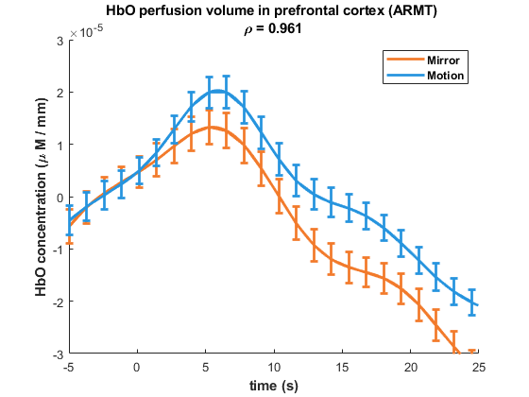
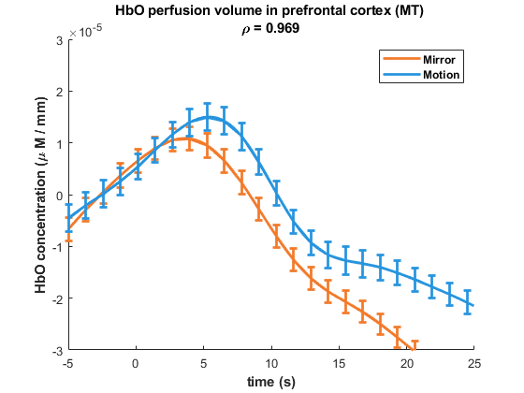
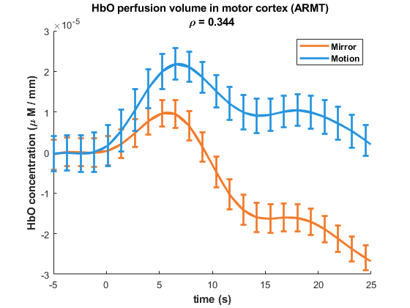
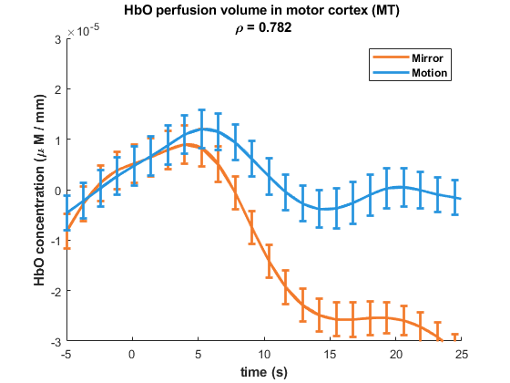
(a)
(b)
(c)
(d)

Slide 21
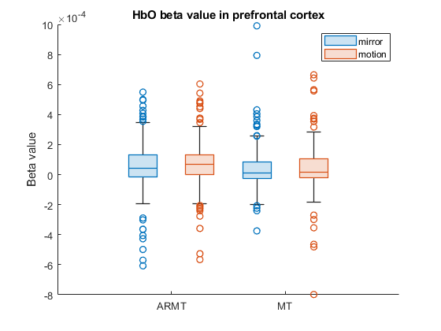
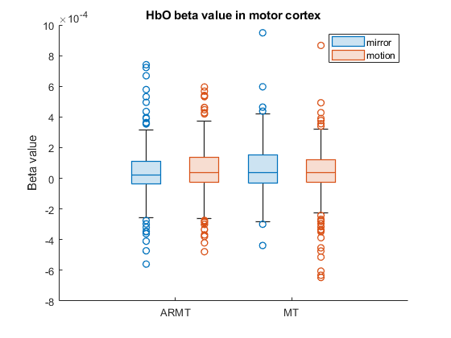
(a)
(b)

Slide 22
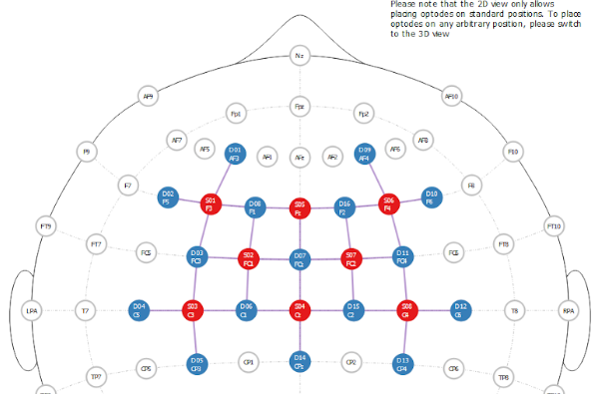
Prefrontal region
Motor region
Mirror side
Motion side

Slide 23
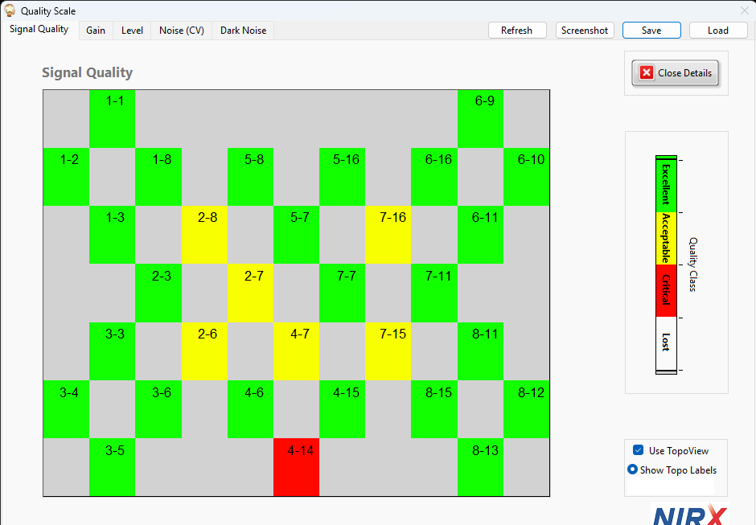
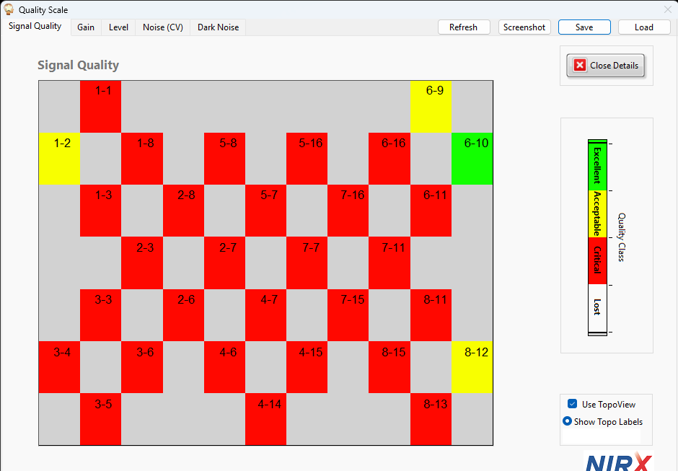
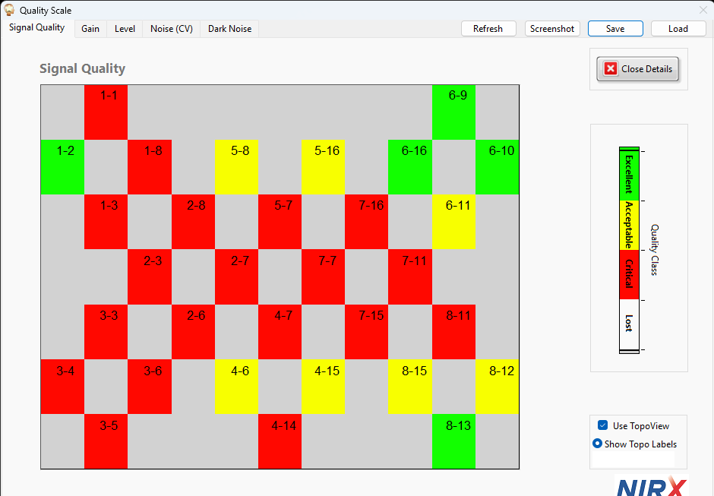
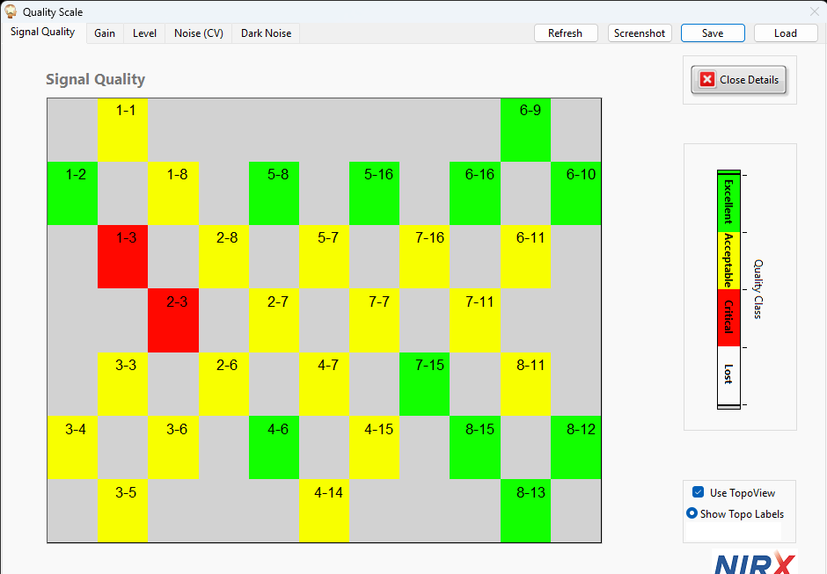

Slide 24
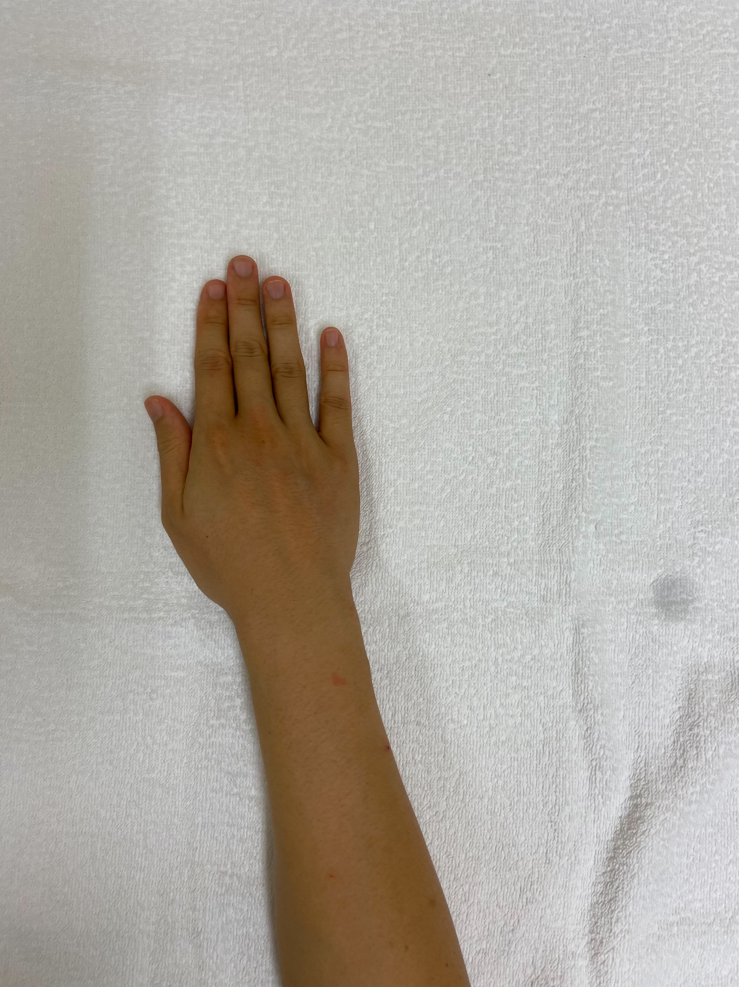
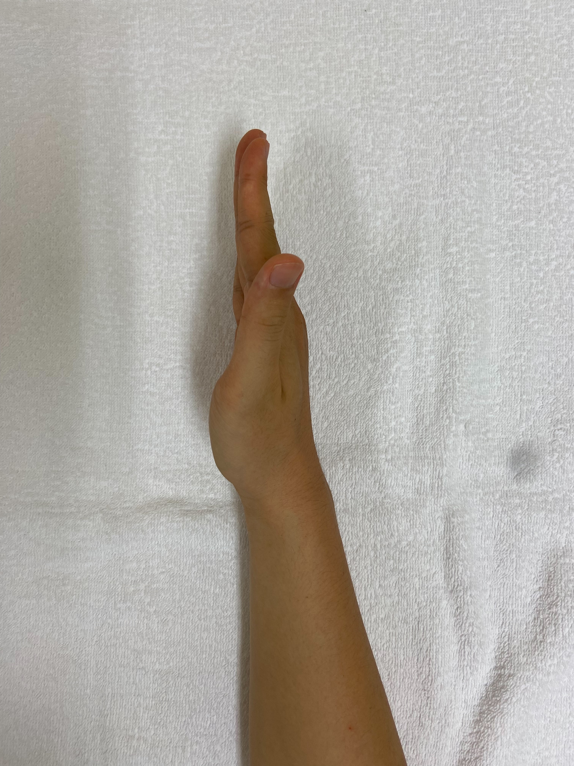
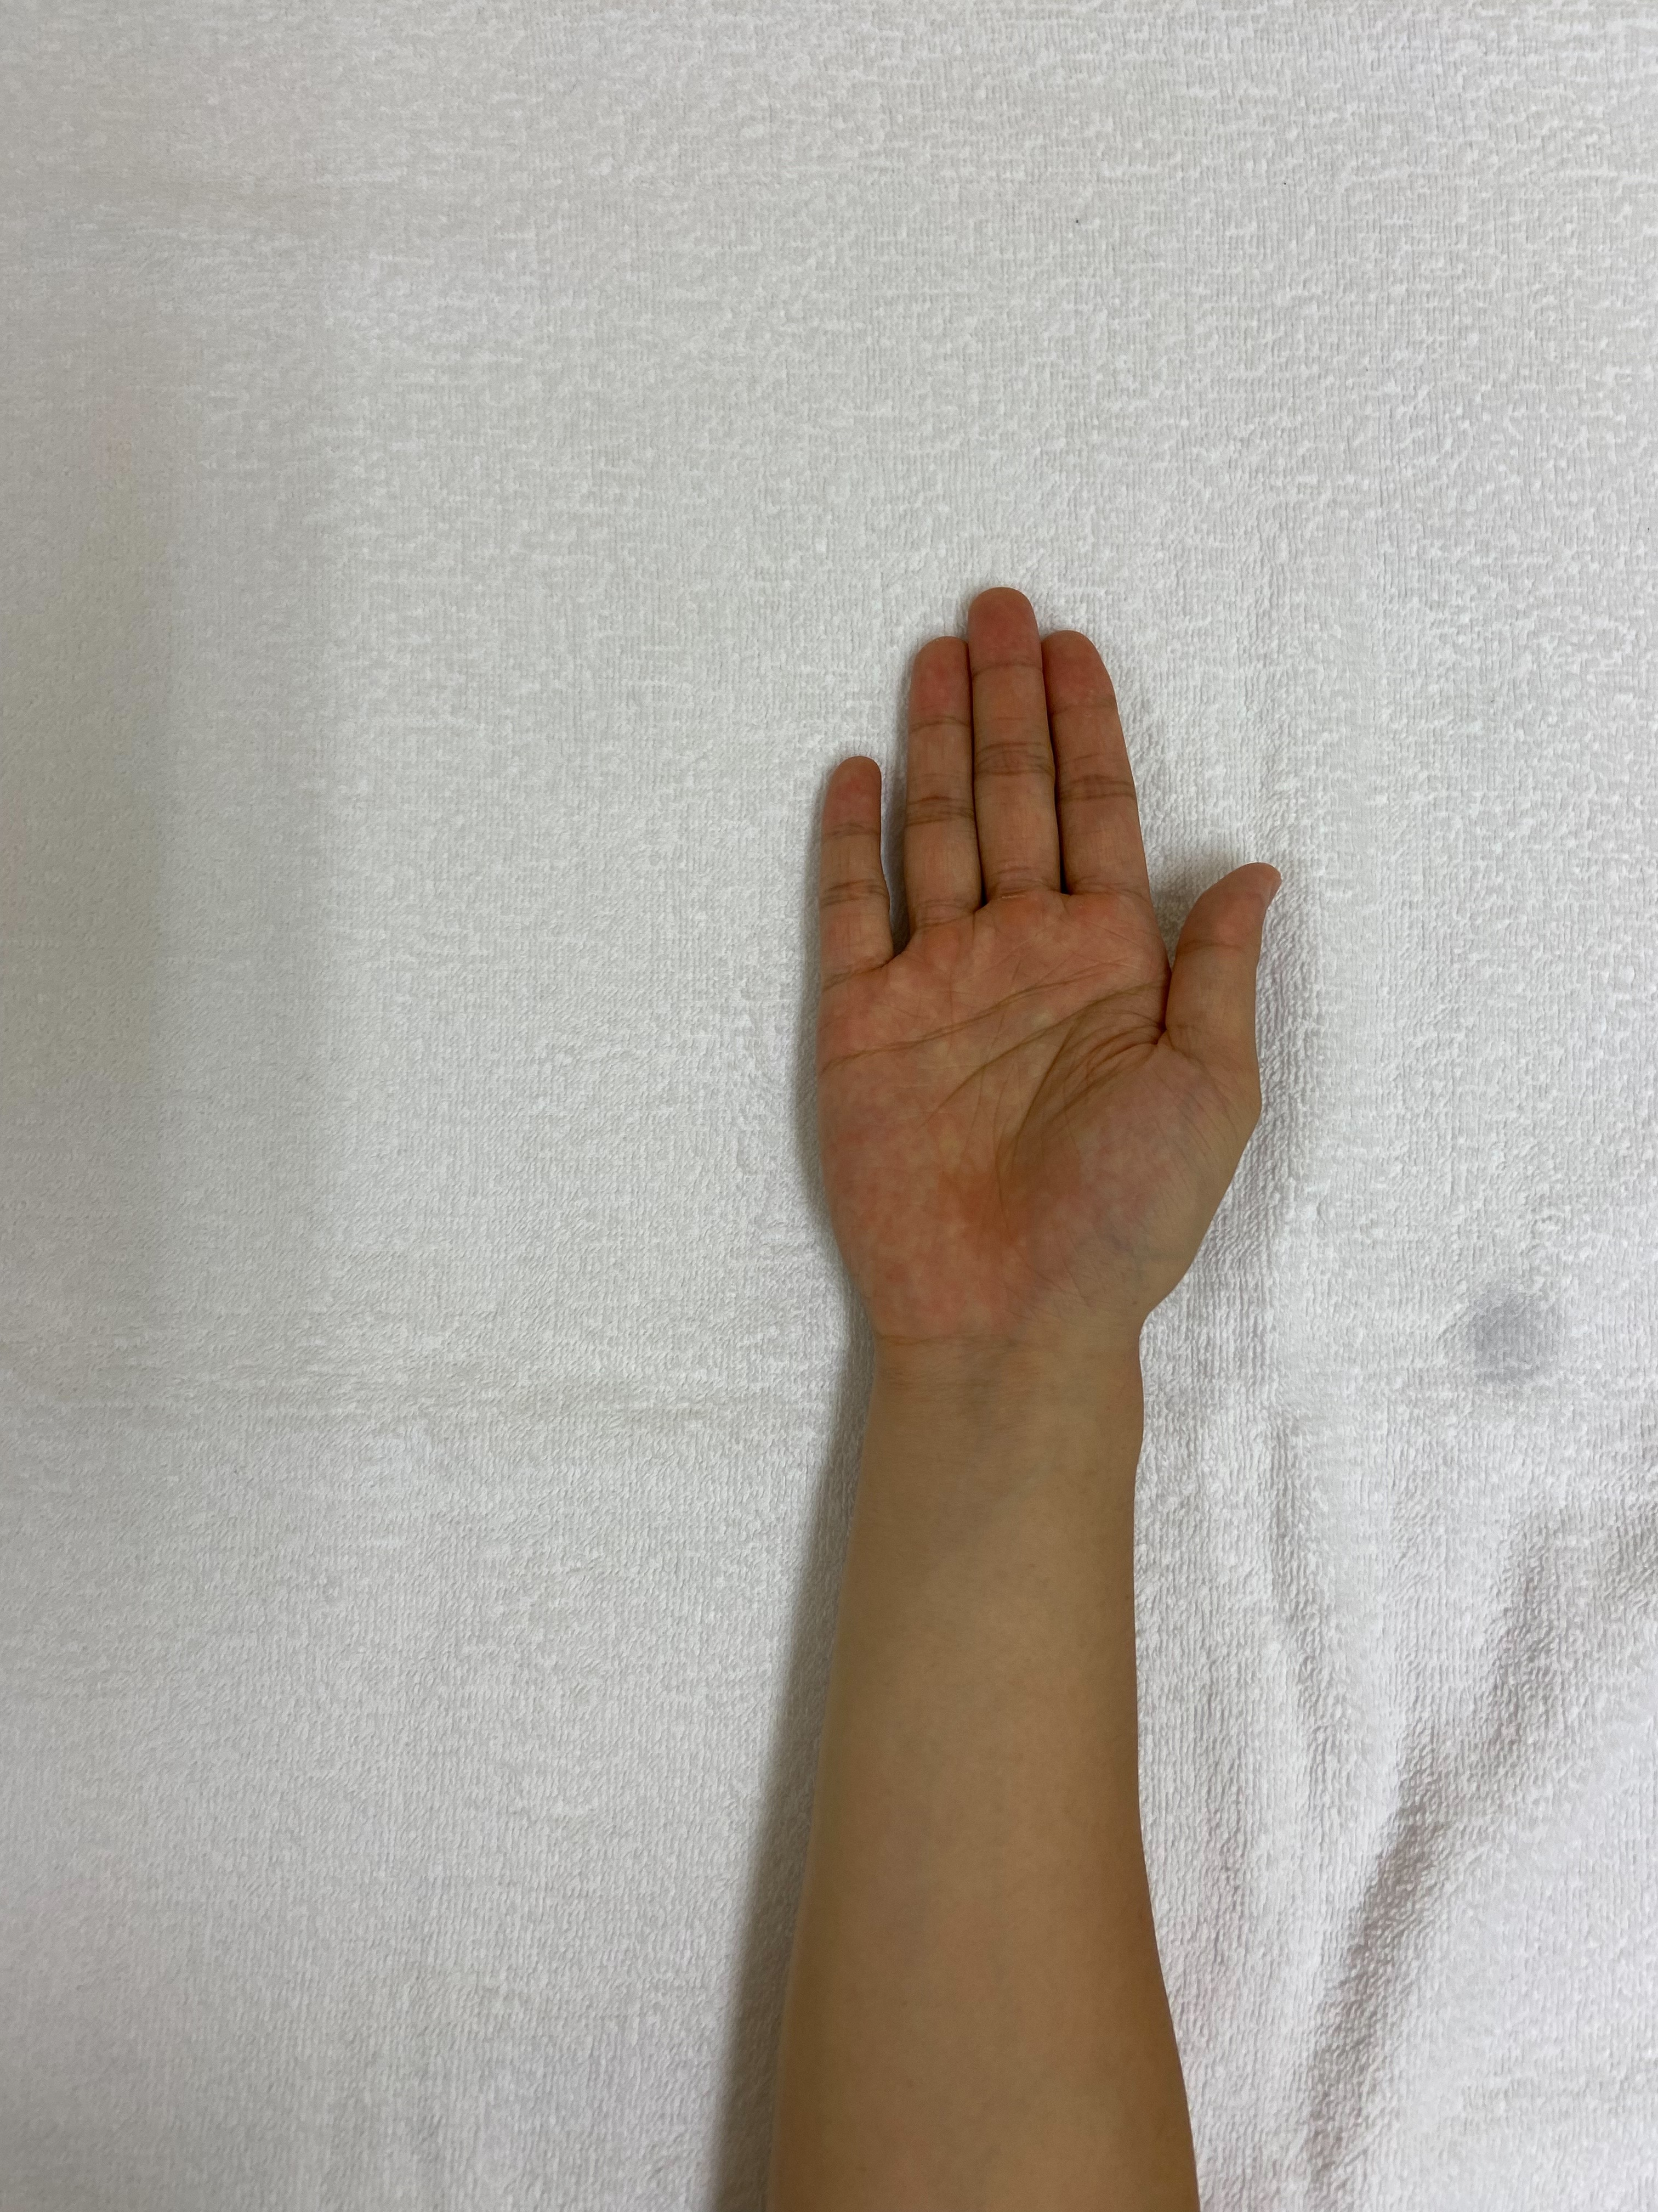
Pronation
Supination

Slide 25
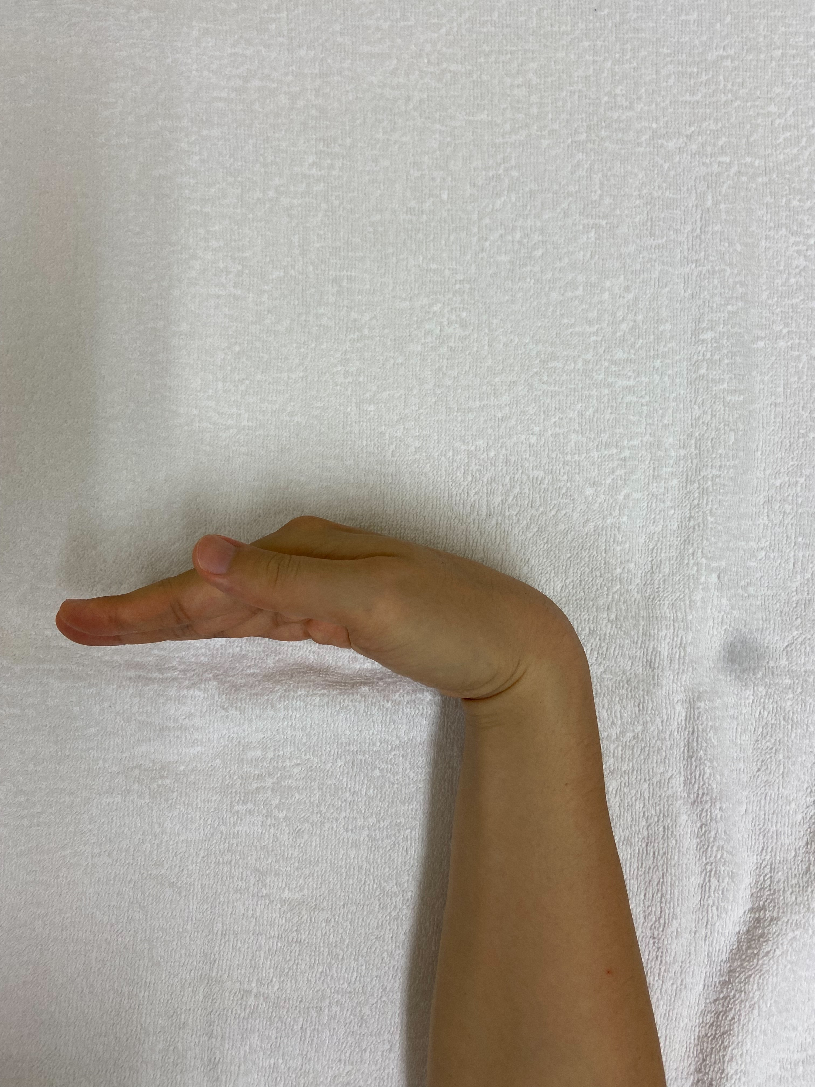
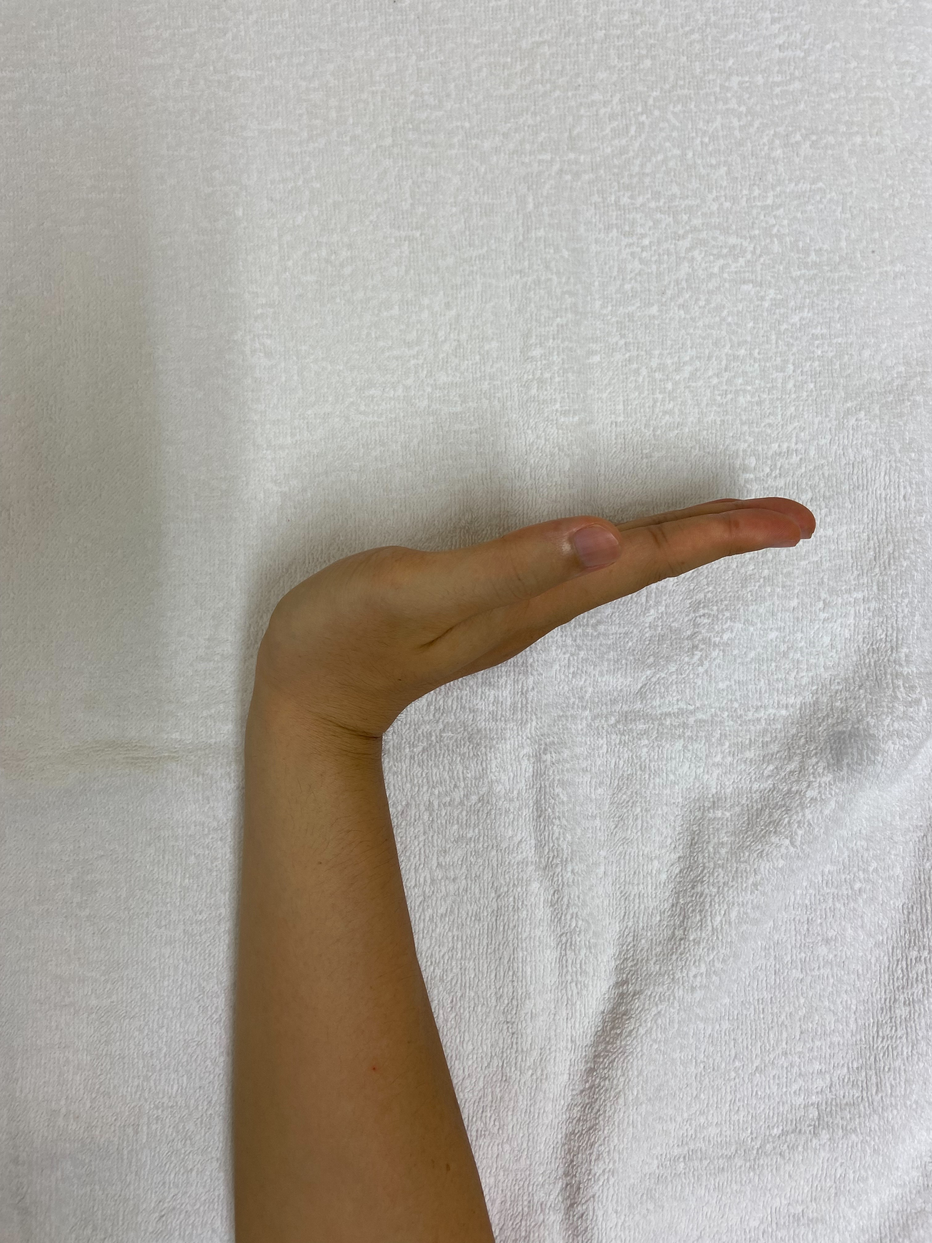
Flexion
Stretch

Slide 26
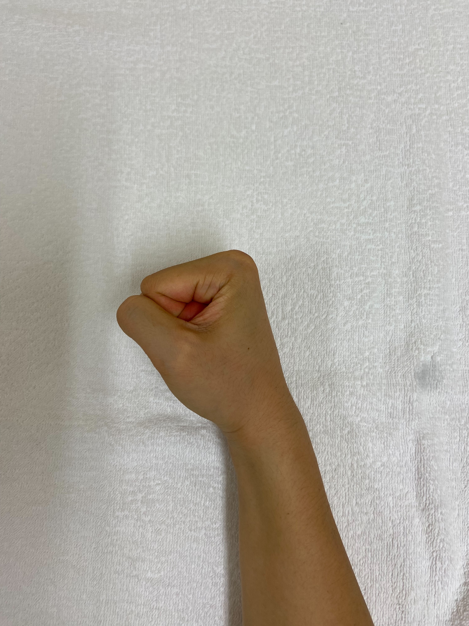
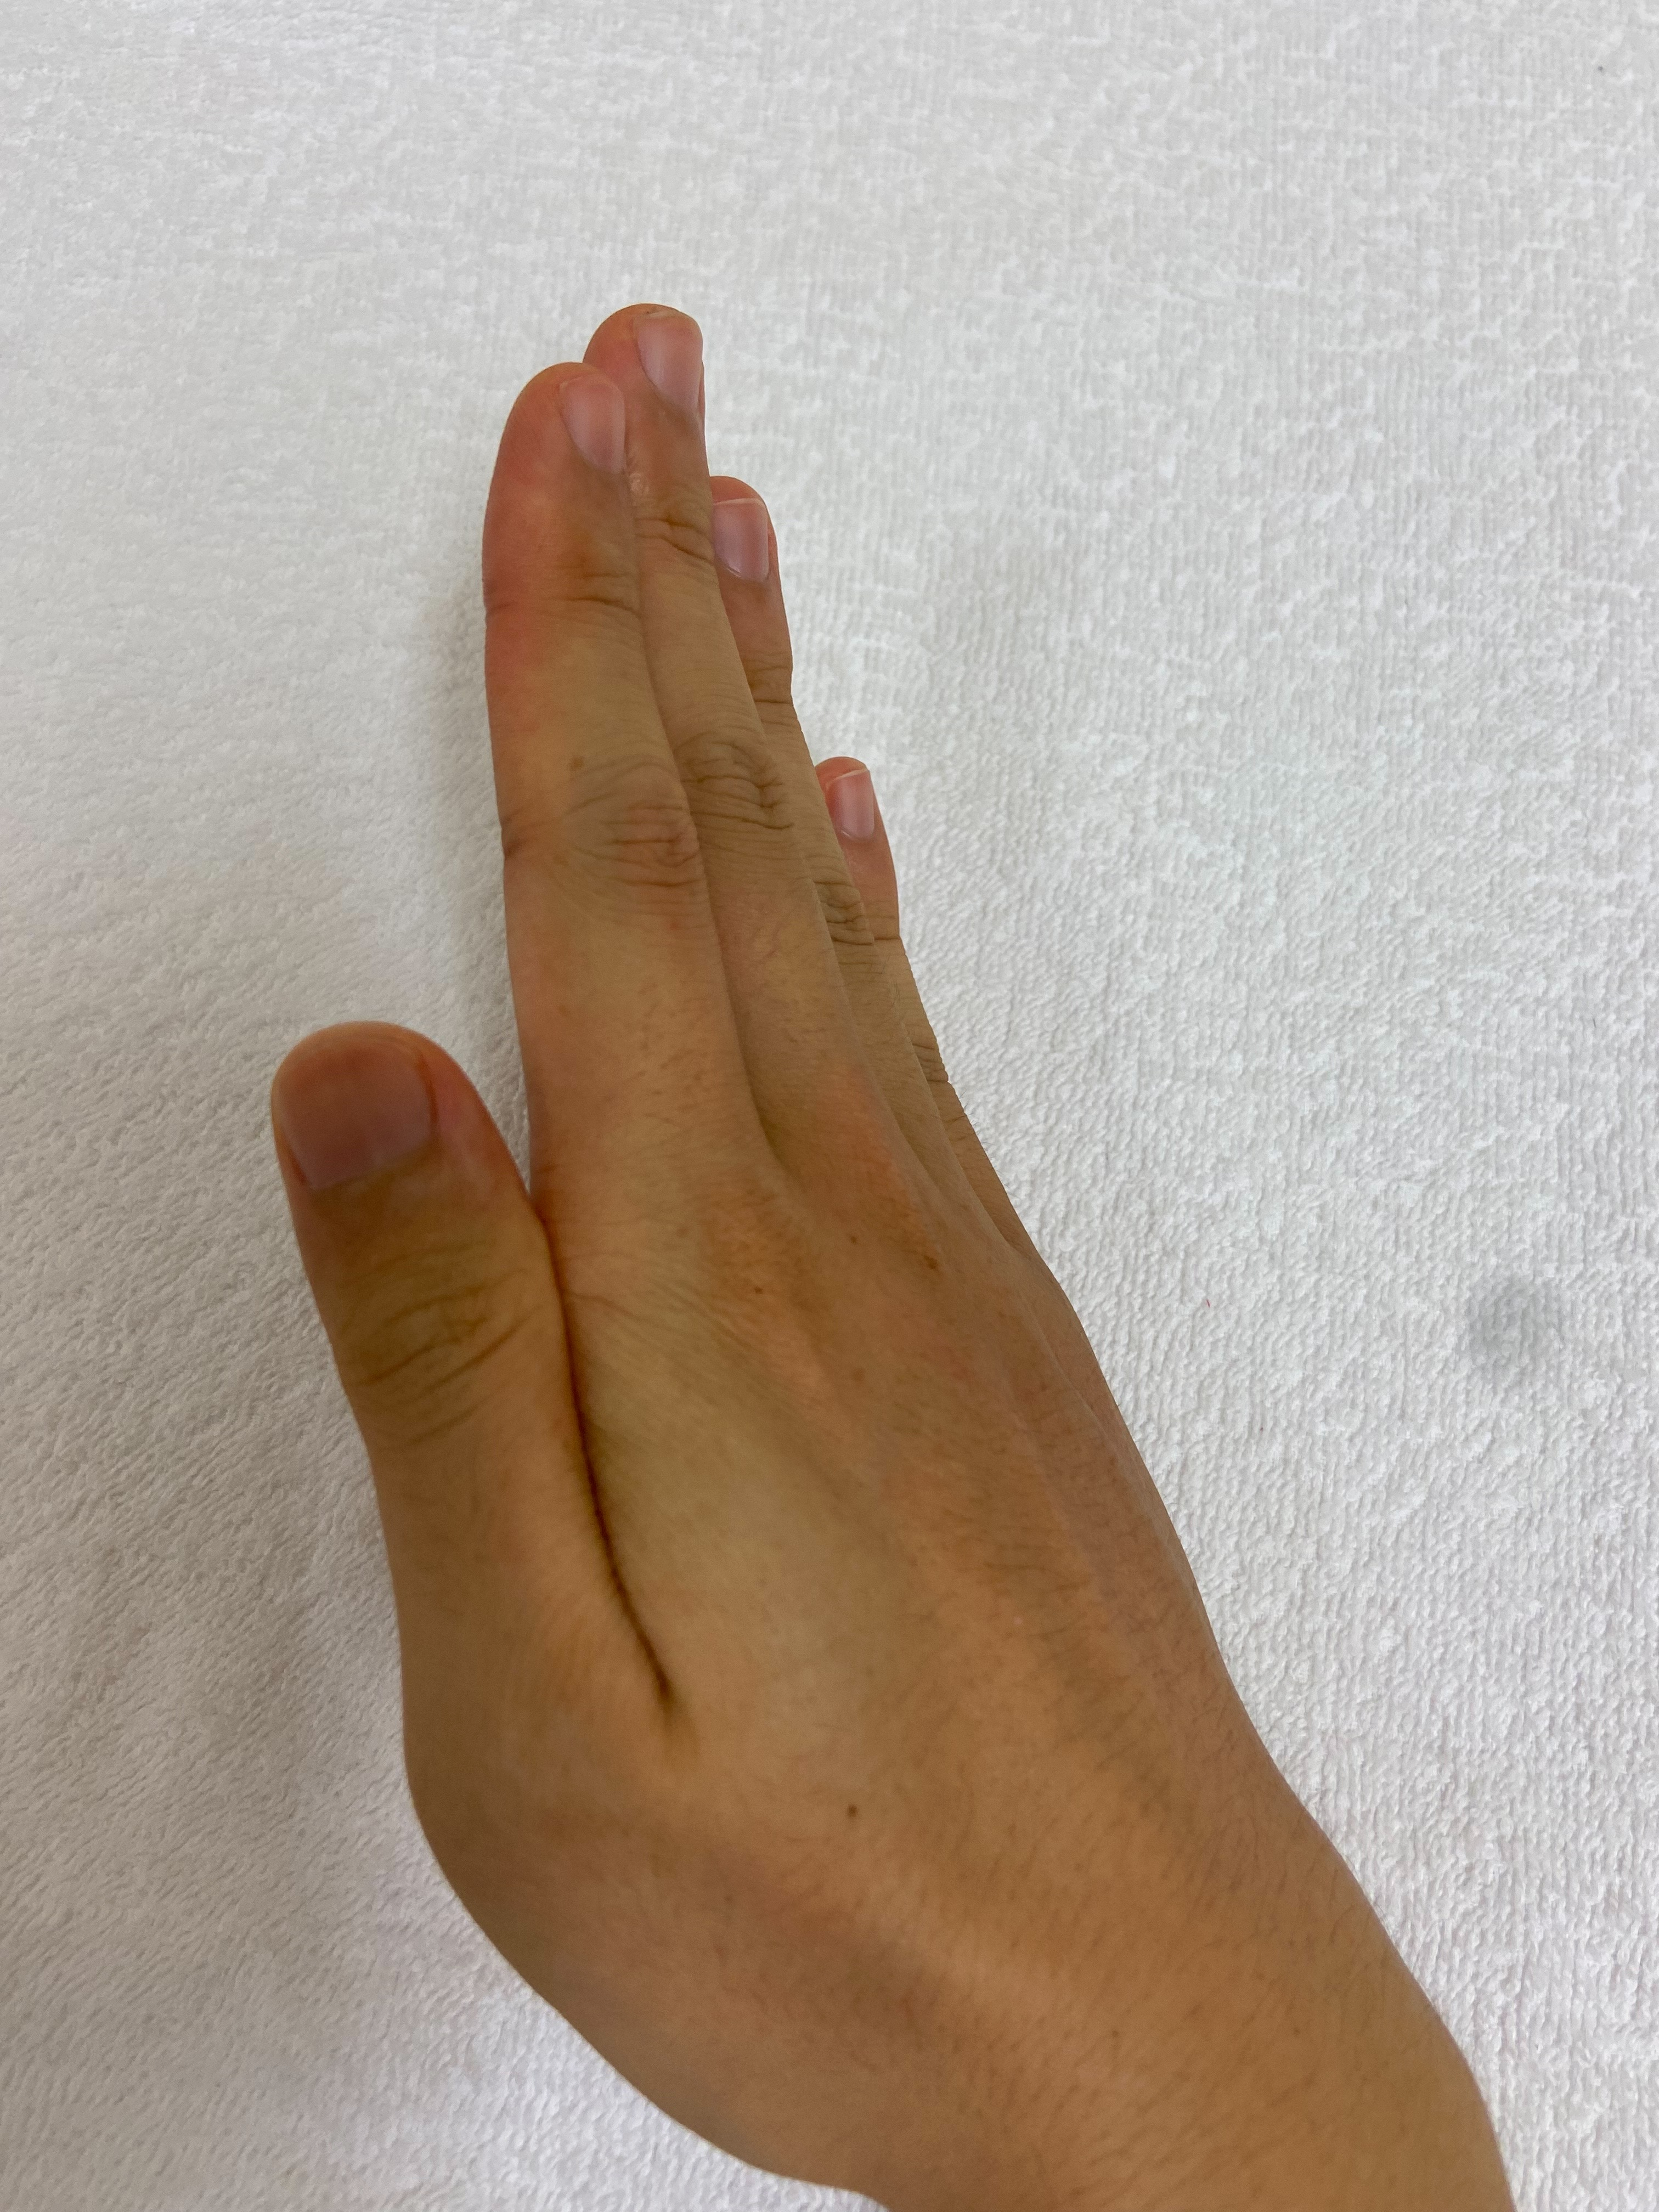
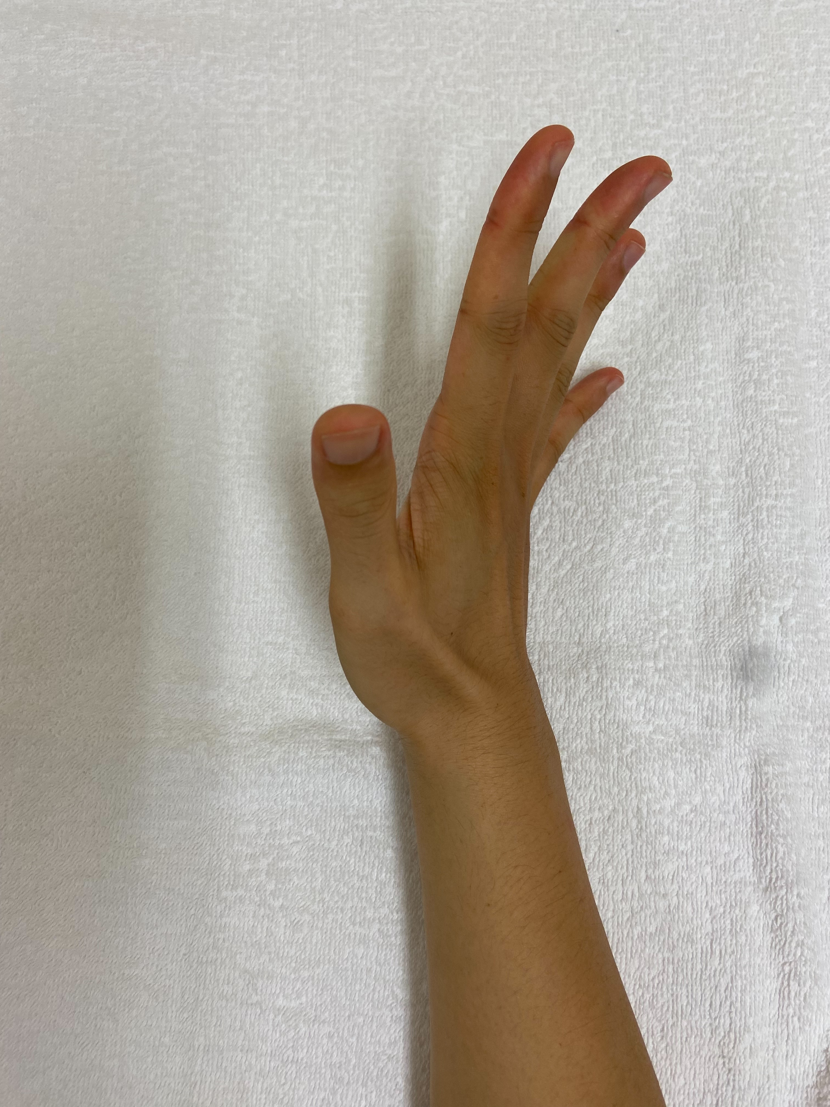
Flexion
Extension

Slide 27
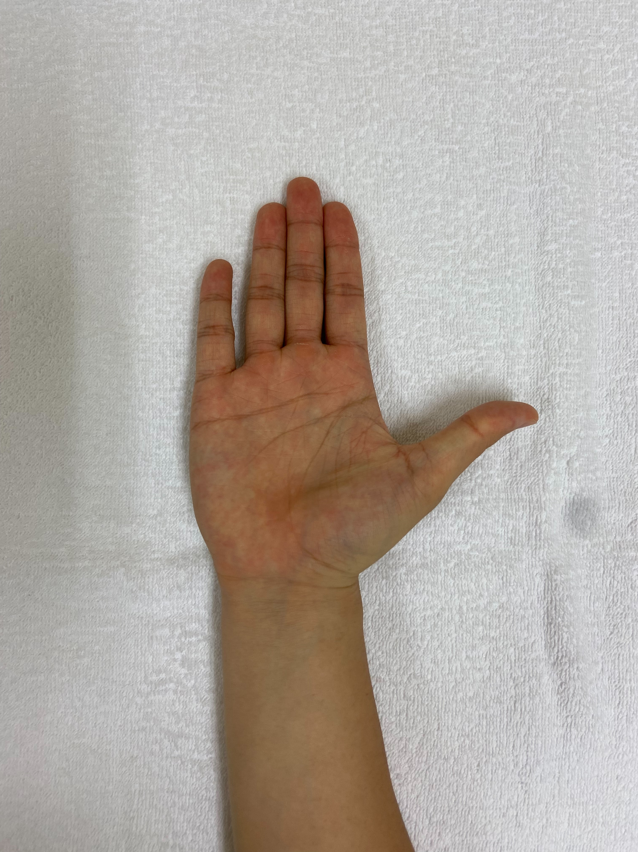
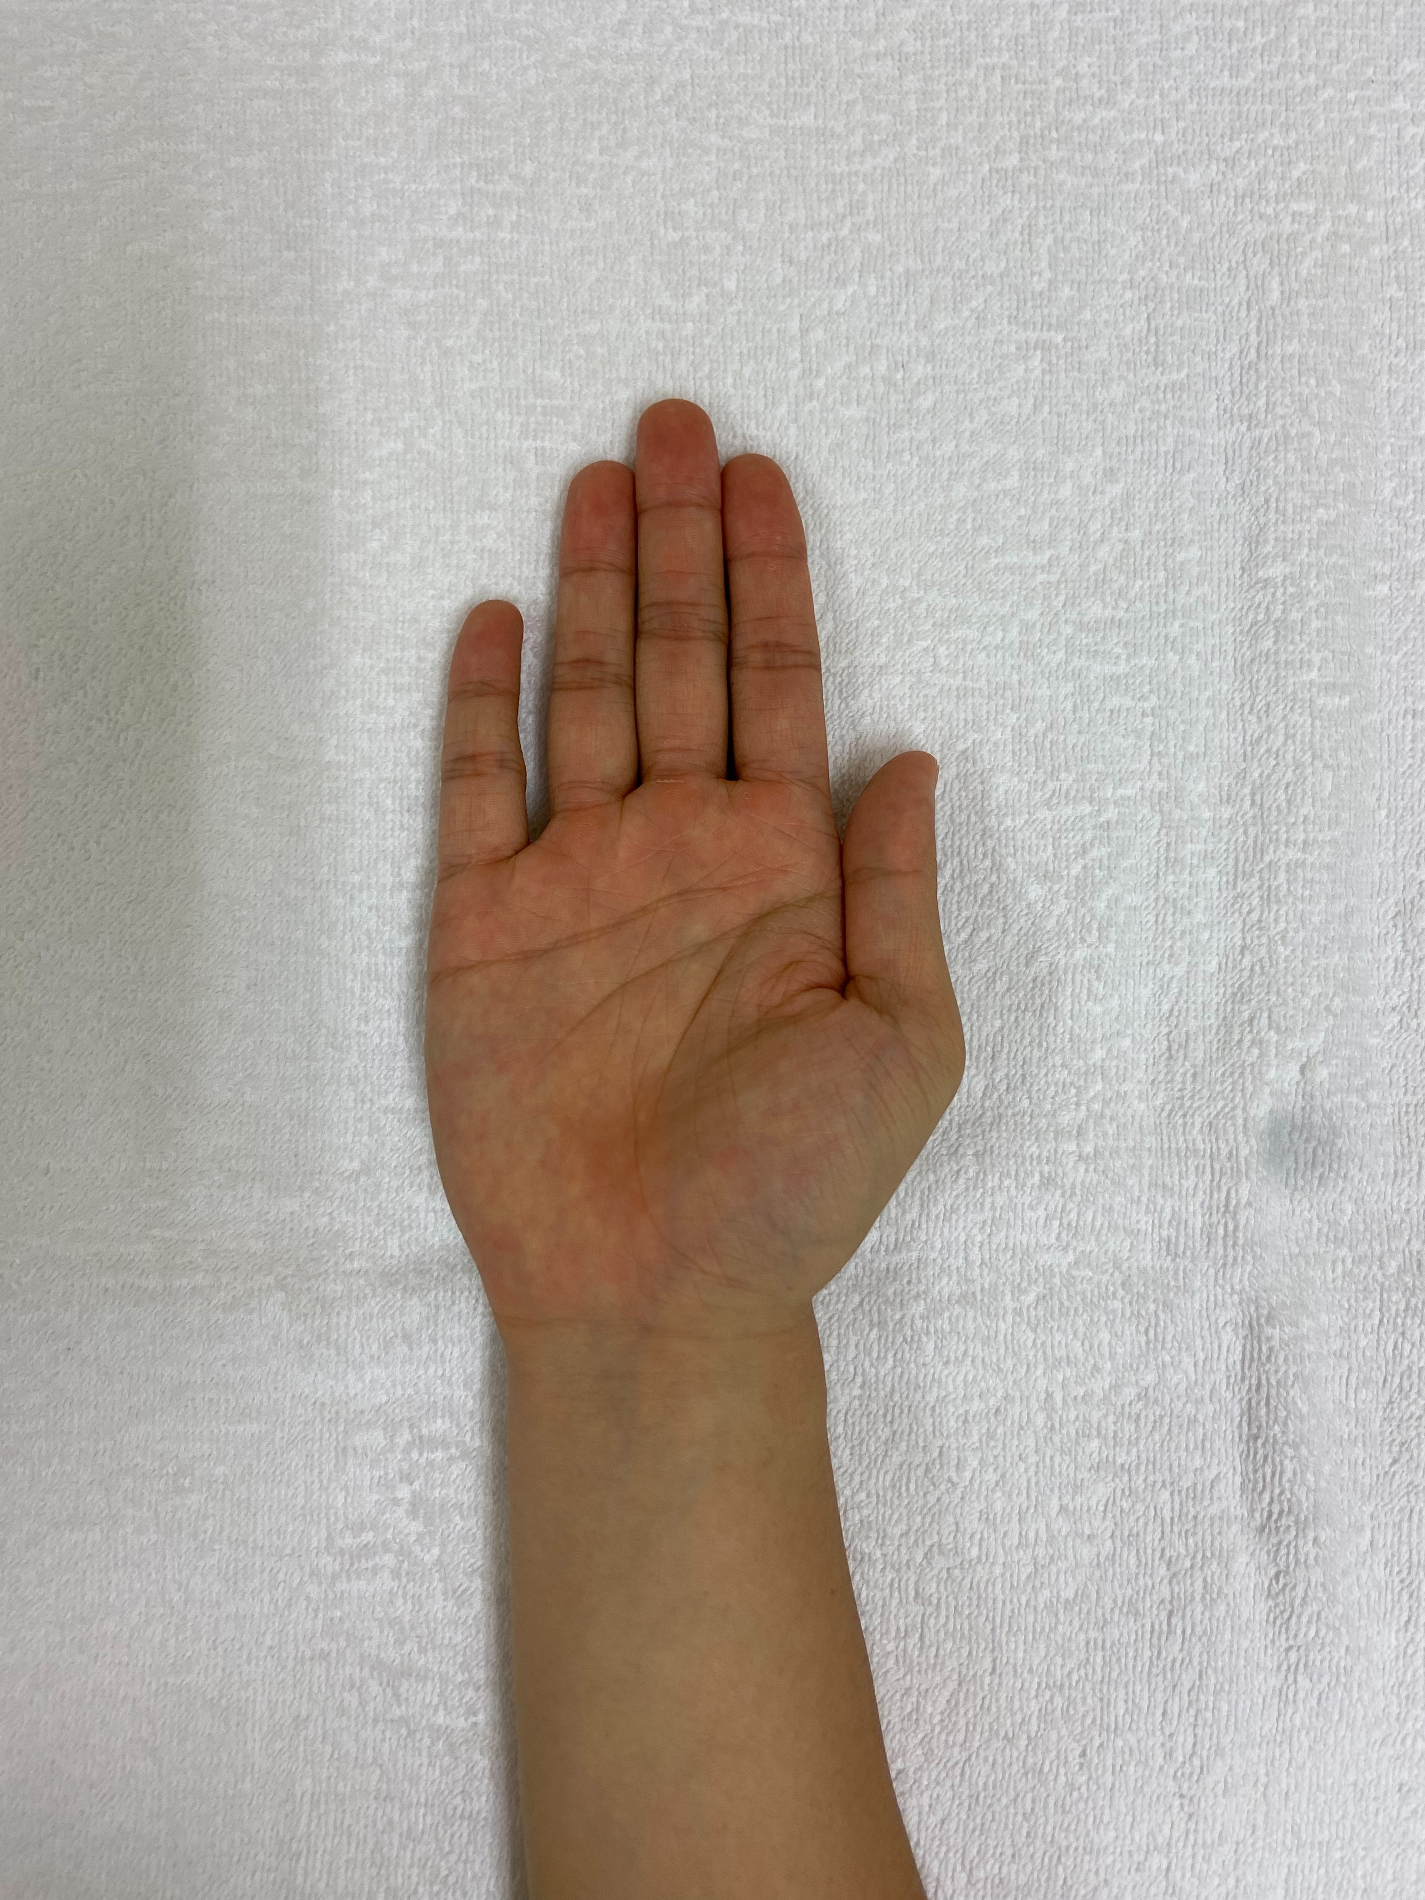
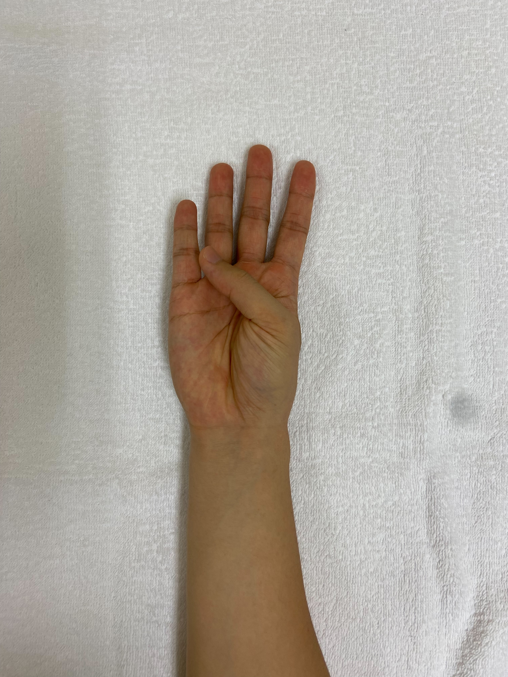
Flexion
Extension

Slide 28
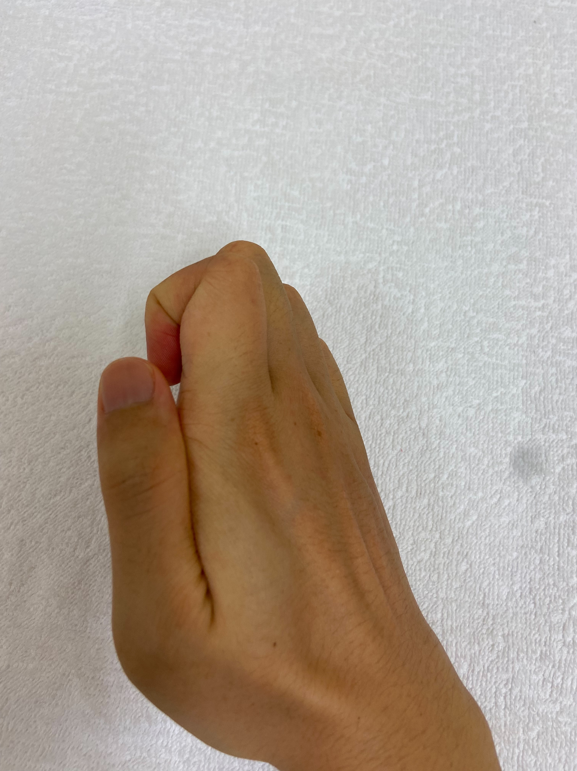
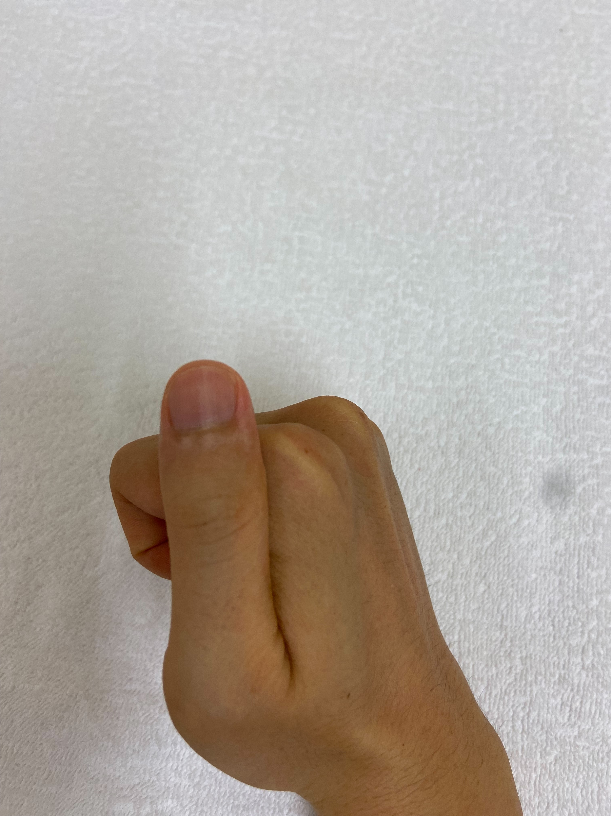

Slide 29
Author (Year) | Duration of the study | Number of patients | Method | Significant improvment of
R. Miclaus et al. (2020) | 9 month | N = 55 (stroke) | Non-immersive VR + Robotic gloves | MMT, FMUE and FIM
L. M. Weber et al. (2019) | 30 min, 12-sessions | N = 10 (stroke) | Immersive VR mirror therapy | FMUE (not significant)
Hsu et al. (2022) | 12 weeks | N = 30 (healthy) N = 45 (stroke) | Immersive VR mirror therapy | FMUE, BBT
G. A. d. Assis et al. (2016) | 4 weeks | N= 8 (stroke) | Non-immersive AR + EMG wristband | FMUE
A. Boschmann et al. (2021) | 6 days | N = 13 (healthy) | Immersive AR + EMG wristband | Number of pins that were successfully transferred
C. Zirbel et al. (2018) | One-time trial | N = 6 (stroke) | Immersive smartphone VR + EMG wristband | No experiment carried out
N. LaPiana et al. (2020) | 1 week | N = 5 (stroke) | Immersive smartphone AR + ARTag anchor | No experiment carried out
MMT: Manual Muscle Testing
FMUE: Fugl-Meyer Assessment for Upper Extremity
FIM: Functional Independence Measure
BBT: Box and block test

